Slide 1
Student Services Website Tour
By: Tiger and Joshua

Slide 2
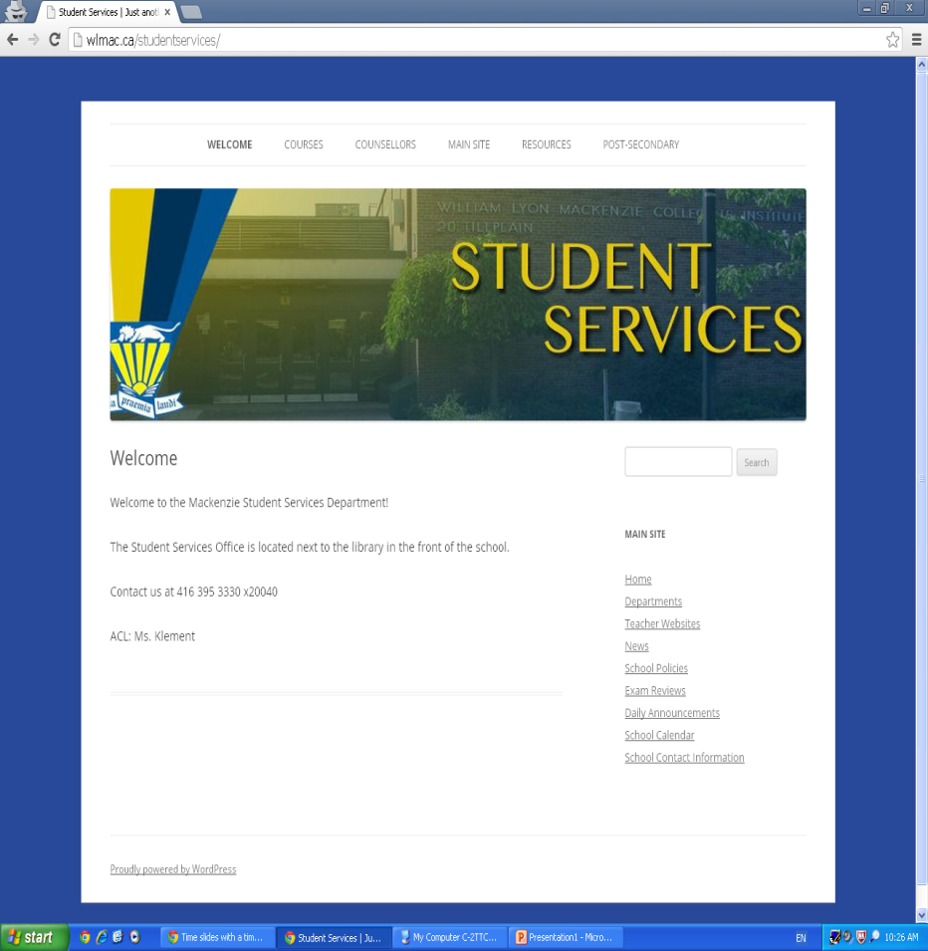
Introduction to the site
The homepage
of the student services
Includes the number to
contact the department,
the location of the office,
menus to other student
Services pages, and links to the
main site

Slide 3
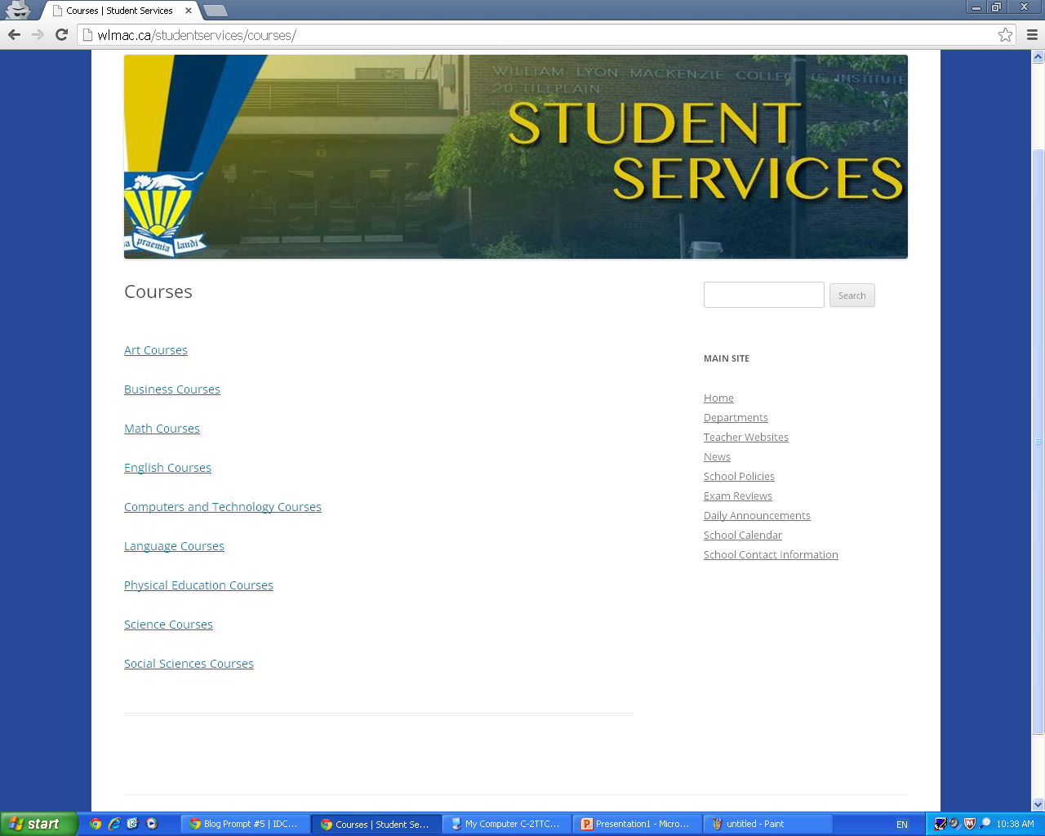
Courses page
After clicking the courses menu you are
brought to a page
with links to the
main site which
has information
on the course type
you chose

Slide 4
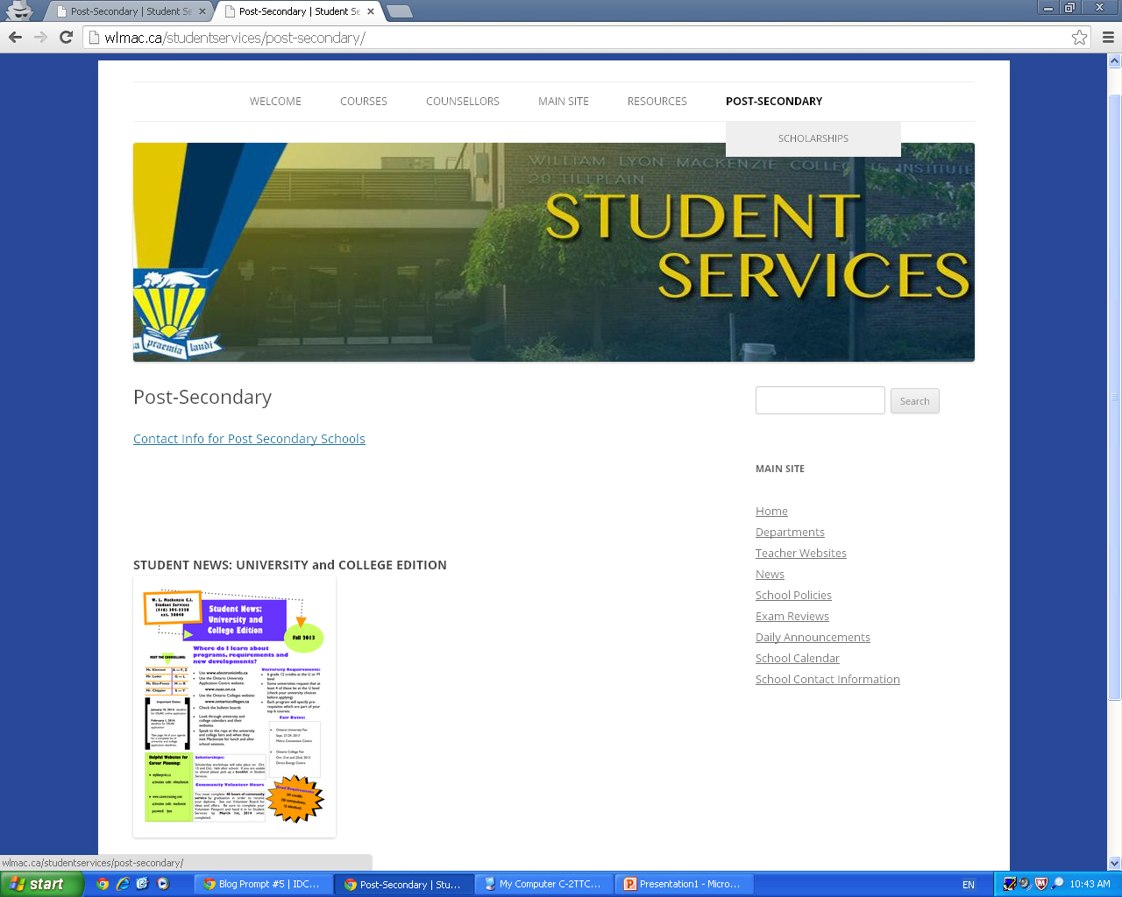
Post secondary
The Post Secondary menu has 2 pages
one brings you to a page
With some info about
applying to
Post Secondary
and a link with
contact info
to post Secondary
Schools

Slide 5
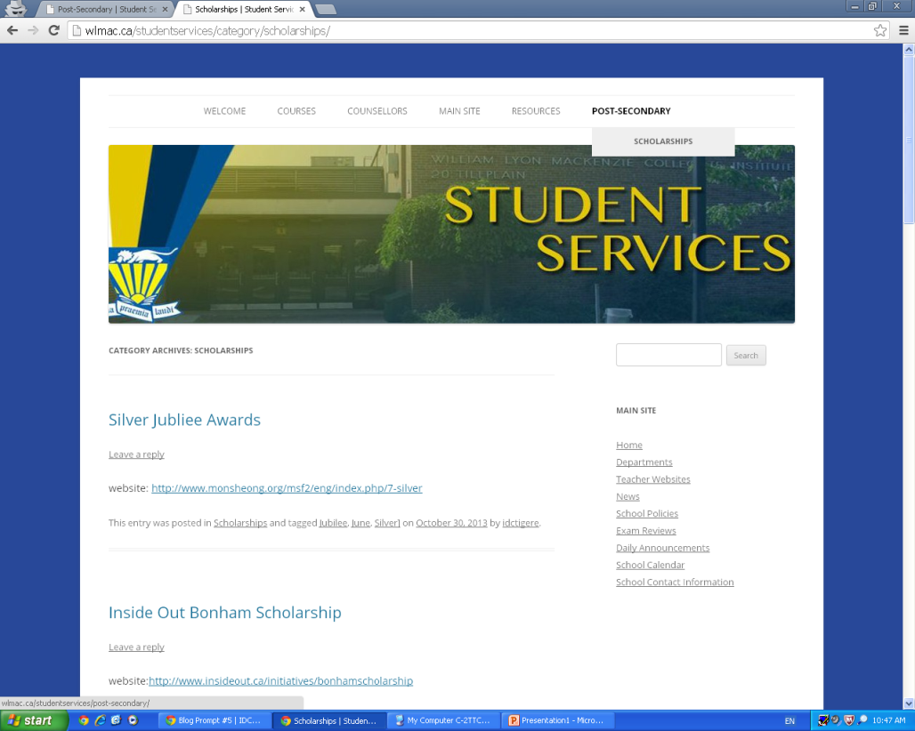
Scholarships
The other menu brings you to a page with Links to many scholarship offered by many different organizations.
Each post is tagged
with the last known
due date and other
relevant information

